Slide 1


Heat and Temperature Year 11 ATAR Physis
Mrs Martin
This Photo by Unknown Author is licensed under CC BY-ND

Slide 2



Do not delete this slide. It is hidden from your show. You can use it to copy and paste the relevant prompt boxes into your presentation. Click once on the white space to select it for copying. Once it is in your presentation you can double click on the white space to add text. The box will automatically resize to fit your text. The next slide is also hidden and included as an example only.
Make the Connection
Check for Understanding
Teacher Cue
Vocabulary
Extension
Hints

Slide 4
What is sound?
Notes:
Sound is a longitudinal wave of vibrating particles (back and forth)

Slide 5
What is sound?
CFU

Slide 6
Question
Hint

Slide 8
What do you already know?
Kinetic Theory – Year 8
What is kinetic theory?
Complete the table below:
State of matter? | Arrangement of atoms | Volume (fixed/variable) | Shape (fixed/variable)
Solid
Liquid
Gas
Notes:
CFU - call on non-volunteers, then open the floor to volunteers
Make the Connection – we deal with mixtures in the form of everyday things around us all the time.

Slide 9
Heat
Sir Francis Bacon proposed the idea that heat is motion. He stated that heat is the rapid vibration of particles.
We currently accept the kinetic particle model.
All matter is made up of particles.
The particles are in constant motion.
There is no kinetic energy lost or gained from the total during elastic collisions.
There are forces of attractions and repulsion between the particles in a material.
The distance between particles varies between states.
Notes:
Teacher Cue – refer to the vocabulary box as you read through and “unpack” the definition provided. Use hand gestures to emphasise the ”2 or more”, “mixed” and “separated” parts of the definition.
Have students complete CFU 1 as a pair-share, then record these definitions & examples as notes (with diagrams) if desired.
CFU 2 – pair-share, then whiteboards for answers – call on non-volunteers.

Slide 10
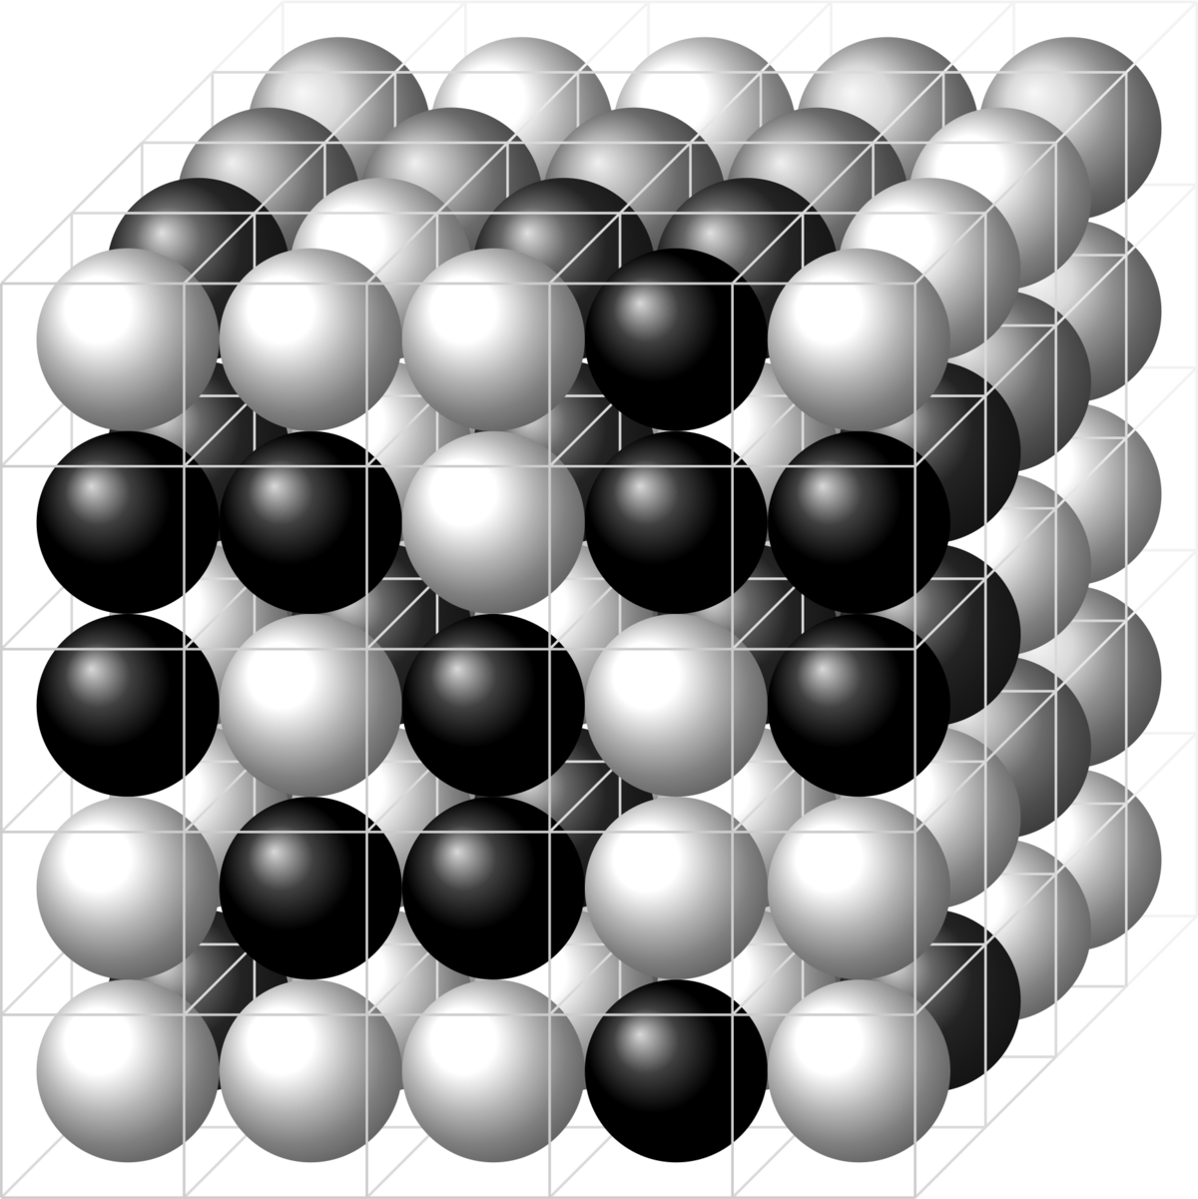
Solid
Attractive and repulsive forces on each other that hold together in the fixed shape.
Forces are balanced.
Fixed volume.
Particles vibrate in fixed position.
Particles have a low kinetic energy.
This Photo by Unknown Author is licensed under CC BY-SA
Notes:
Teacher Cue – refer to the vocabulary box as you read through and “unpack” the definition provided. Use hand gestures to emphasise the ”2 or more”, “mixed” and “separated” parts of the definition.
Have students complete CFU 1 as a pair-share, then record these definitions & examples as notes (with diagrams) if desired.
CFU 2 – pair-share, then whiteboards for answers – call on non-volunteers.

Slide 11
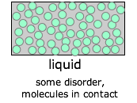
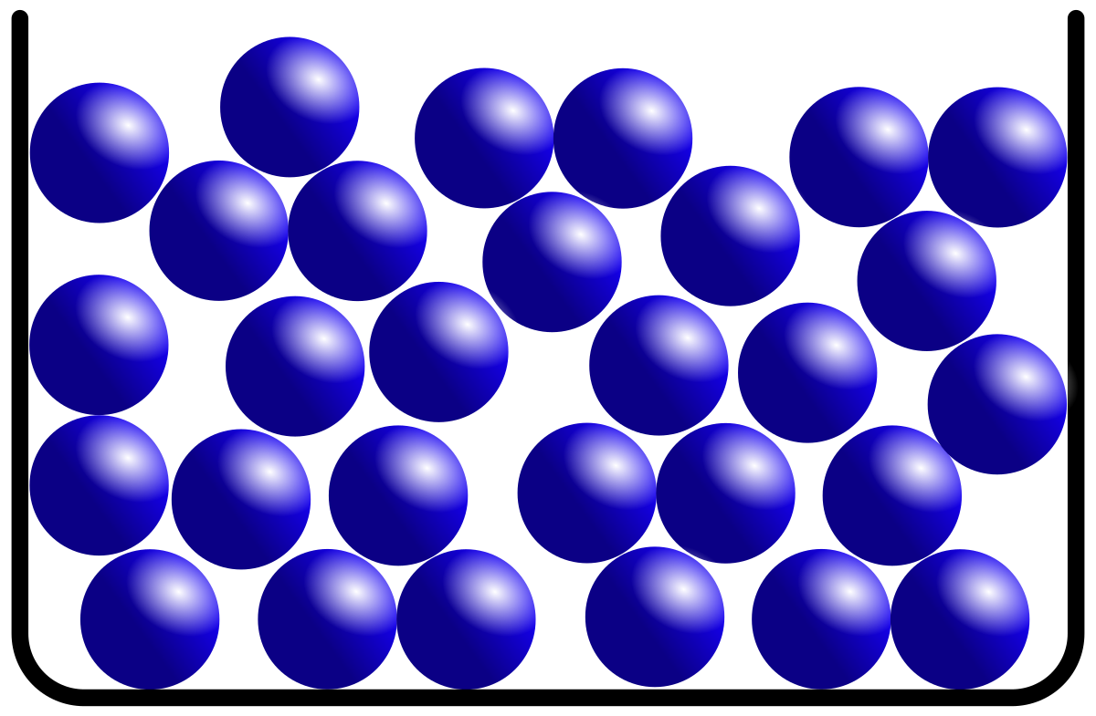
Liquid
Forces are balanced.
Variable shape.
Particles are able to collide and remain attracted to each other.
Fixed volume.
This Photo by Unknown Author is licensed under CC BY-SA
Notes:
Teacher Cue – refer to the vocabulary box as you read through and “unpack” the definition provided. Use hand gestures to emphasise the ”2 or more”, “mixed” and “separated” parts of the definition.
Have students complete CFU 1 as a pair-share, then record these definitions & examples as notes (with diagrams) if desired.
CFU 2 – pair-share, then whiteboards for answers – call on non-volunteers.

Slide 12
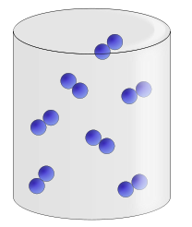
Gases
Particles are fast moving.
Variable shape.
Variable volume.
Particles have a high kinetic energy.
When particles collide the attractive forces are not strong enough to keep them together.
The repulsive forces make the particles move off in different directions.
Notes:
Teacher Cue – refer to the vocabulary box as you read through and “unpack” the definition provided. Use hand gestures to emphasise the ”2 or more”, “mixed” and “separated” parts of the definition.
Have students complete CFU 1 as a pair-share, then record these definitions & examples as notes (with diagrams) if desired.
CFU 2 – pair-share, then whiteboards for answers – call on non-volunteers.

Slide 13
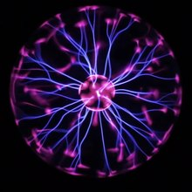
Plasma
4th state of matter.
Plasma exists when matter is heated to very high temperatures resulting in electrons being freed.
Ionisation – when gases loose electrons.
Protons = Electrons
This Photo by Unknown Author is licensed under CC BY-SA
Notes:
Teacher Cue – refer to the vocabulary box as you read through and “unpack” the definition provided. Use hand gestures to emphasise the ”2 or more”, “mixed” and “separated” parts of the definition.
Have students complete CFU 1 as a pair-share, then record these definitions & examples as notes (with diagrams) if desired.
CFU 2 – pair-share, then whiteboards for answers – call on non-volunteers.

Slide 14
Bose-Einstein condensate
5th state of matter.
Exists very close to absolute zero.
The point at which the movement in the particles almost stops.
Atoms clump together and show properties of super fluid.
Notes:
Teacher Cue – refer to the vocabulary box as you read through and “unpack” the definition provided. Use hand gestures to emphasise the ”2 or more”, “mixed” and “separated” parts of the definition.
Have students complete CFU 1 as a pair-share, then record these definitions & examples as notes (with diagrams) if desired.
CFU 2 – pair-share, then whiteboards for answers – call on non-volunteers.

Slide 15

Vocabulary
Thermal energy – energy contained in a system that is responsible for its temperature
Kinetic energy – energy of motion
Potential energy – stored energy (in bonds)
Internal energy – total kinetic and potential energy within a substance.
Heat
Heat - Transfer of thermal energy from a hotter body to colder body.
When an item is heated there will be a net gain in kinetic energy or potential energy.
Gain in kinetic energy – gain in temperature.
Gain in potential energy – change in state or expansion of object (no temp change).
Notes:
Teacher Cue – refer to the vocabulary box as you read through and “unpack” the definition provided. Use hand gestures to emphasise the ”2 or more”, “mixed” and “separated” parts of the definition.
Have students complete CFU 1 as a pair-share, then record these definitions & examples as notes (with diagrams) if desired.
CFU 2 – pair-share, then whiteboards for answers – call on non-volunteers.

Slide 16
Temperature
Fahrenheit and Celsius are the two most common scales used to indicate the temperature.
Two of the most notable points on the Celsius scale are 0^{O}C and 100^{O}C.
0^{O}C – is known as freezing point of water.
This is the point where water will turn from a liquid into a solid. The particles are still vibrating in place.
This Photo by Unknown Author is licensed under CC BY-SA
Notes:
Teacher Cue – refer to the vocabulary box as you read through and “unpack” the definition provided. Use hand gestures to emphasise the ”2 or more”, “mixed” and “separated” parts of the definition.
Have students complete CFU 1 as a pair-share, then record these definitions & examples as notes (with diagrams) if desired.
CFU 2 – pair-share, then whiteboards for answers – call on non-volunteers.

Slide 17
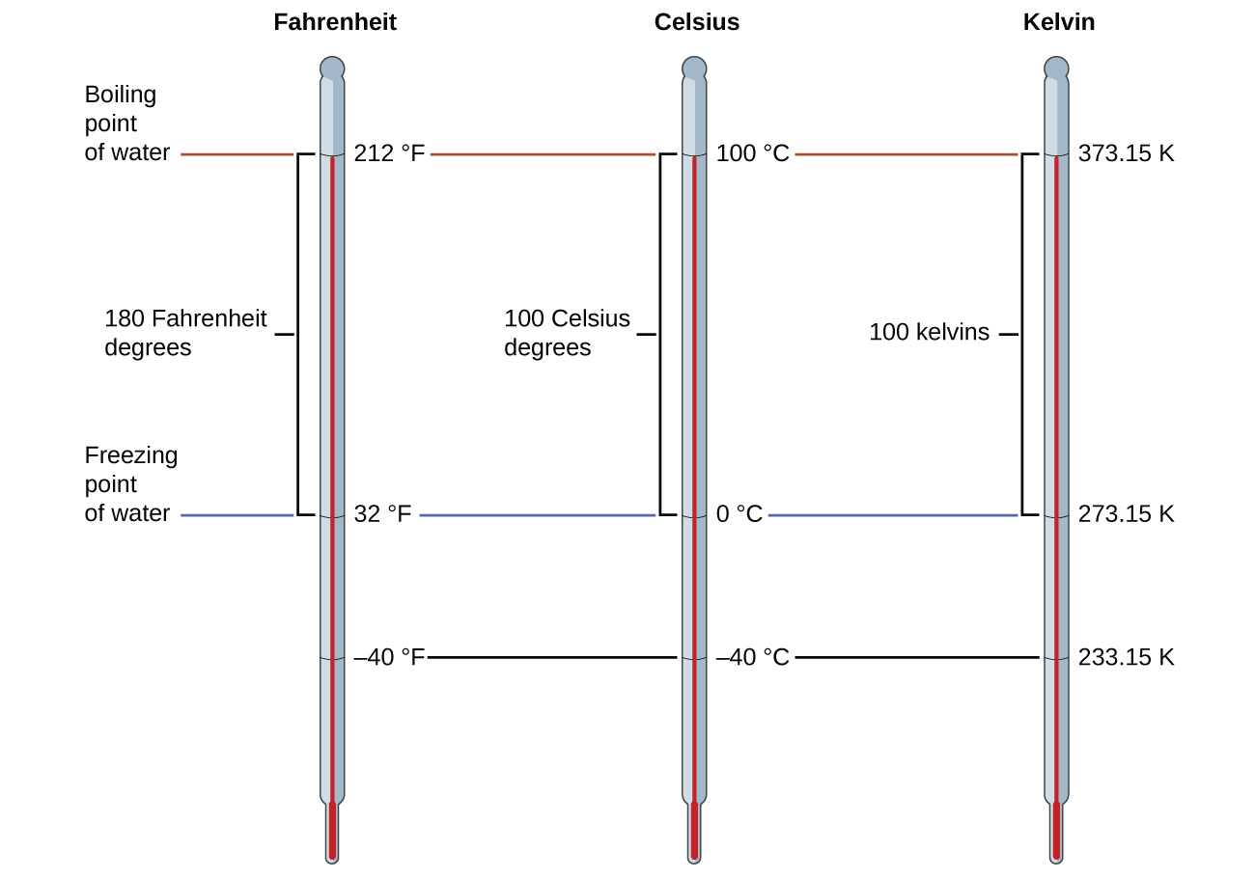
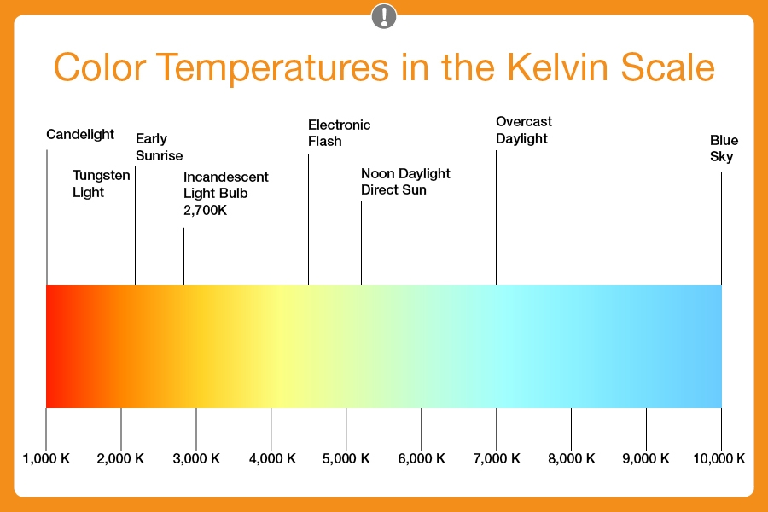
Kelvin Scale (K)
The Kelvin scale is known as the absolute scale for temperature as it does not have negative values.
The lowest point on the Kelvin scale is known as ‘absolute zero’.
Absolute Zero
All molecular motion ceases at absolute zero. The coldest temperature possible.
0K = -237.15^{O}C
Unit sizes between ^{O}C and K are equal.
This Photo by Unknown Author is licensed under CC BY-NC
Notes:
Teacher Cue – refer to the vocabulary box as you read through and “unpack” the definition provided. Use hand gestures to emphasise the ”2 or more”, “mixed” and “separated” parts of the definition.
Have students complete CFU 1 as a pair-share, then record these definitions & examples as notes (with diagrams) if desired.
CFU 2 – pair-share, then whiteboards for answers – call on non-volunteers.

Slide 18
Kelvin Scale (K)
The Kelvin scale is known as the absolute scale for temperature as it does not have negative values.
The lowest point on the Kelvin scale is known as ‘absolute zero’.
Absolute Zero
All molecular motion ceases at absolute zero. The coldest temperature possible.
0K = -237.15^{O}C
Unit sizes between ^{O}C and K are equal.
This Photo by Unknown Author is licensed under CC BY-NC
Notes:
Teacher Cue – refer to the vocabulary box as you read through and “unpack” the definition provided. Use hand gestures to emphasise the ”2 or more”, “mixed” and “separated” parts of the definition.
Have students complete CFU 1 as a pair-share, then record these definitions & examples as notes (with diagrams) if desired.
CFU 2 – pair-share, then whiteboards for answers – call on non-volunteers.

Slide 19
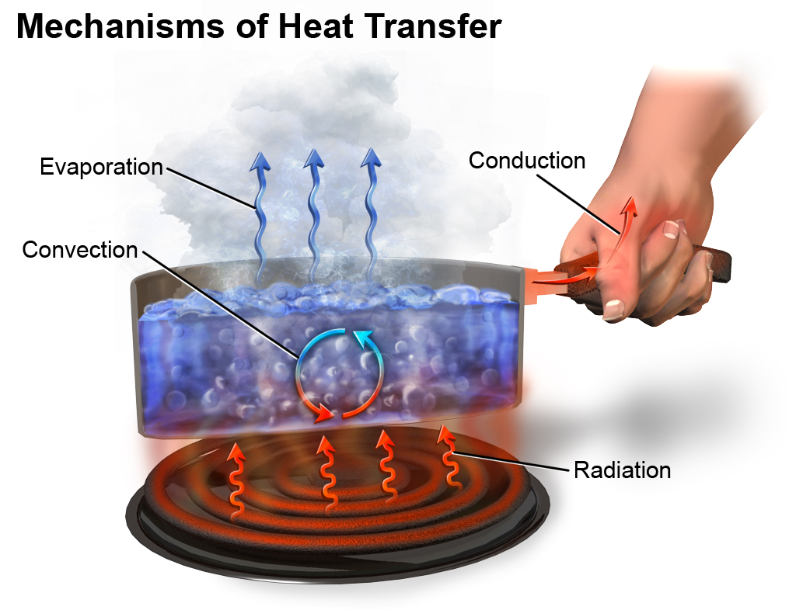
Energy Transfer
Two objects that are in contact within one another but have different temperatures, energy from the hotter object will transfer from the hotter object to cooler object.
One object will increase in temperature whilst the other decreases.
The transfer of energy will stop when the two objects are at the same temperature (thermal equilibrium).
This Photo by Unknown Author is licensed under CC BY-SA
Notes:
Teacher Cue – refer to the vocabulary box as you read through and “unpack” the definition provided. Use hand gestures to emphasise the ”2 or more”, “mixed” and “separated” parts of the definition.
Have students complete CFU 1 as a pair-share, then record these definitions & examples as notes (with diagrams) if desired.
CFU 2 – pair-share, then whiteboards for answers – call on non-volunteers.

Slide 20
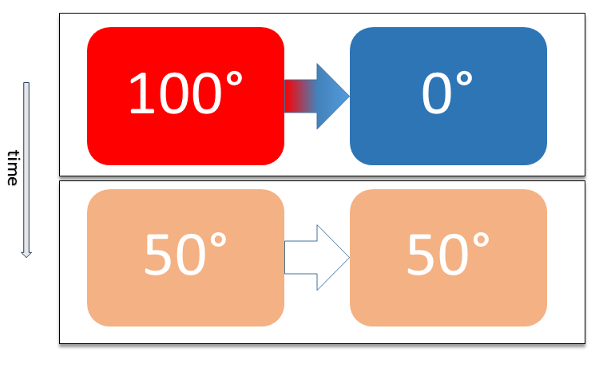
Thermal Equilibrium
When two objects have the same temperature.
Zeroth Law of Thermodynamics
When two objects in contact are at the same temperature.
This Photo by Unknown Author is licensed under CC BY-SA
Notes:
Teacher Cue – refer to the vocabulary box as you read through and “unpack” the definition provided. Use hand gestures to emphasise the ”2 or more”, “mixed” and “separated” parts of the definition.
Have students complete CFU 1 as a pair-share, then record these definitions & examples as notes (with diagrams) if desired.
CFU 2 – pair-share, then whiteboards for answers – call on non-volunteers.

Slide 21
Vocabulary
Mechanical Work– a measure of the the energy transferred by a force
First Law of Thermodynamics
The law states that energy changes from one form to another and the total energy in an isolated system remains constant.
Internal energy (U) – total internal kinetic and potential energy in a system. Heat and mechanical work can be added or removed from a system resulting in a change in the internal energy.
Heat (Q)
Mechanical Work (W)
∆U = Q + W
Notes:
Teacher Cue – refer to the vocabulary box as you read through and “unpack” the definition provided. Use hand gestures to emphasise the ”2 or more”, “mixed” and “separated” parts of the definition.
Have students complete CFU 1 as a pair-share, then record these definitions & examples as notes (with diagrams) if desired.
CFU 2 – pair-share, then whiteboards for answers – call on non-volunteers.

Slide 22
Practice.
Work through the problems:
Pearson 11 - 1.1 pg 10
STAWA 11 - Problem Set 1 pg 16
Notes:
Teacher Cue – refer to the vocabulary box as you read through and “unpack” the definition provided. Use hand gestures to emphasise the ”2 or more”, “mixed” and “separated” parts of the definition.
Have students complete CFU 1 as a pair-share, then record these definitions & examples as notes (with diagrams) if desired.
CFU 2 – pair-share, then whiteboards for answers – call on non-volunteers.

